Slide 1
Rare and Non Protein Amino Acids
By
Professor
Dr. Jamal Ahmed Abdel -Barry

Slide 2
Rare Amino Acids
In addition to 20 standard amino acids there are several amino acids that can be isolated from the hydrolysis of special type of protein, all are derivatives of some standard amino acids.
4 - Hydroxy Proline is found in fibrous protein especially
collagen.
5 - Hydroxy Lysine is also present in collagen.
3 - Iodo Tyrosine is present in thyroid gland.
These amino acids are present in low concentration such as collagen.

Slide 3
Non Protein Amino Acids
In addition to 20 common and several types of rare
amino acids of protein, a number of amino acids are known
to occur in biological system as free or combined but never in protein, some non-protein amino acids are important intermediate in metabolism such as Homo Histidine , Homo Serine, Ornithine, Citrulline, are intermediate in synthesis of Arginine in the urea cycle, B-Aniline is the building block of vitamin.

Slide 4
Essential and Non-Essential Amino Acids
The non-essential amino acids are those amino acids that can be synthesized by the body, where as the other amino acids that can not be synthesized in the body are called essential amino acids and they must be supplement in the diet, the concentration of essential must increase when the amount of non-essential amino acids decrease, the number of essential amino acids are 9 and they are:
1. Phenyl Alanine 2. Methionine
3. Threonine 4. Leucine
5. Isoleucine 6. Arginine
7. Valine 8. Lysine
9. Tryptophan 10. Histidine (in infant)
There are 9 essential amino acids for adult,
And 10 essential amino acids in infant.
The remaining amino acids (of the standard 20) are non-
essential.

Slide 5
The Chemical Reactions of Amino Acids
a. Reactions of Carboxyl group.
b. Reactions of Amino group.
c. Reactions R-group.

Slide 6
A. Reactions of Carboxyl group:
The carboxyl group of amino acids undergo
the same reactions of organic carboxylic group.
1. Formation of amide
2. Formation of ester
3. Formation of acid halide
4. Decarboxylation to give amine
5. Reduction with dansyl chloride
6. Reduction with LiBeH₄

Slide 7
B. Reactions of amino group:
1. Acetylating of α – amino group.
The α – amino group with benzyl carbonate.
2. Reaction with a non-hydrine which is used to estimate the amino acid quantitavely, all amino acids give a blue color with a non-hydrine except for Proline and 4-Hydroxy
Proline which will give a yellow color (why?)
Because they contain NH rather than NH₂

Slide 8
C. Reactions of R-group (phenolic):
The hydroxyl group of Tyrosine gives Millonse, the guanidine group of the Arginine gives Sakaguchi, the aromatic group of Tyrosine and Tryptophan gives Hopkins-Cole, the Thiol group of Cysteine oxidize to give Cystine.

Slide 9
Acid, Base properties of Amino Acids:
Amino acids in a polar solvent present as crystalline form as dipolar ions or zwitterions.

Slide 10
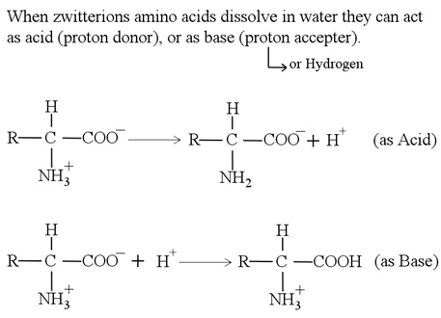

Slide 11
Peptide (Polypeptides)
The polymerization of amino acids by a peptide bond
forming low molecular weight polypeptides and high
molecular weight protein.

Slide 12
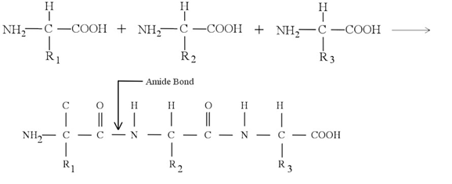
Peptide Bond:
It is a covalent amide bond formed by the reaction of carboxyl group from first amino acid with amine group from second amino acid.

Slide 13
The compound is known as peptide or protein depends
on the number of amino acids:
If it contains less than 50 amino acids it is called polypeptide
While the compound containing 50 or more amino acids is called protein.
On the other hand they are classified based on molecular weight, high molecular weight compounds are proteins.
Active insulin contain 51 AA, So it is a protein.

Slide 14
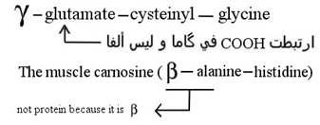
Peptides of Non-Protein Origin
In addition to the peptide that is formed after hydrolysis of protein, a number of peptides that are non-protein contain non-protein amino acids such as Glutathione, it contains: Glutamic acid linked through gama carboxyl group to glycine and Cysteine.
Oxytocin and vasopressin are hormones, they are polypeptides and not protein in origin.

Slide 15
Chemical Reaction of Polypeptides:
The N - terminal of amino group of peptides undergo the same chemical reaction of NH₂
Also the C - terminal of polypeptides or protein have the same reaction of COOH.
Biuret Reaction: for peptide bond:
This is specific for polypeptides and proteins, copper in alkaline medium react with a peptide bond of amino acids of the peptides and proteins to give violet color.

Slide 16
Protein:
Are a complex nitrogenous compound of a high molecular weight building up of large number of amino acids, through a peptide bond.
All contains mainly carbon, hydrogen, nitrogen, sulfur, and oxygen.
Some proteins contain elements such as P, Fe, Zn, & Cu.
In protein molecules the amino acids residue are covalently linked to form a very long unbranched chain.

Slide 17
Functions of Protein:
Protein can provide several functions:
1. Enzymes: All enzymes are protein, but not all proteins
are enzymes.
2. Nutrition: Storage protein provide a source of nutrient such as Albumin.
3. Protection: Most of antibodies and immunoglobulin are proteins.

Slide 18
4. Contraction: The proteins Myosin and Actin are
involved in muscle contraction.
5. Body Structure: The Keratin exist a Varity structure in
hair, skin, nails, and the nervous system. Collagen is a
type of protein present in connective tissues Elastin is
present in walls of blood vessels.
6. Transport: It is used to carry all ions that are not
soluble in plasma such as Calcium and Bilirubin.
7. Maintaining the osmotic pressure such as albumin.
8. Hormones: Number of hormones are proteins such as
insulin.

Slide 19
Classification of Proteins
Proteins are divided into two classed based on the composition:
1. Simple Protein : Are those proteins that give only amino acids
on hydrolysis.
2. Complex (Conjugated) Protein: Are those proteins that give
amino acids and other organic or inorganic molecules linked
covalently, and they are called prosthetic group.
All prosthetic groups are linked covalently.
The Conjugated Protein can be classified based on the chemical
nature of their prosthetic groups such as Nucleoprotein,
Lipoprotein, Phosphoprotein, Glycoprotein, and Metalloprotein.

Slide 20
Protein can be classified according on the shape
1. Fibrous Protein:
Consist of polypeptide chains arranged in a parallel
along single axis to give a long fiber or a sheet.
Fibrous proteins are water in soluble and they have
axial ratio (length : width) of more than 10, they are
structural elements in connective tissues such as
collagen, bone matrix and keratin of hair, skin, and
nails.

Slide 21
2. Globular Protein:
The polypeptides are folded in a compact spherical or globular shape, most globular proteins are soluble in water and have axial ratio of less than 10, such as enzymes, number of hormones and albumin.
3. In Between:
Having axial ratio of more than 10, they are soluble in water,
such as Myosin and Fibrogenin.

